Slide 1


Vocabulary Builder App
Learn English vocabulary effectively with our interactive app. Perfect for students preparing for SAT and GRE exams.
Featuring flashcards, word search, and quizzes that adapt to your proficiency level for optimal retention and progress.
by MOHIT AILANI

Slide 2




Problem Statement
Vocabulary Challenges
Traditional Methods
Current approaches are tedious and fail to provide personalized learning experiences.
Many individuals struggle to expand their vocabulary effectively despite its importance.
Digital Gap
Increasing reliance on digital platforms reveals a lack of comprehensive vocabulary builder apps.

Slide 3
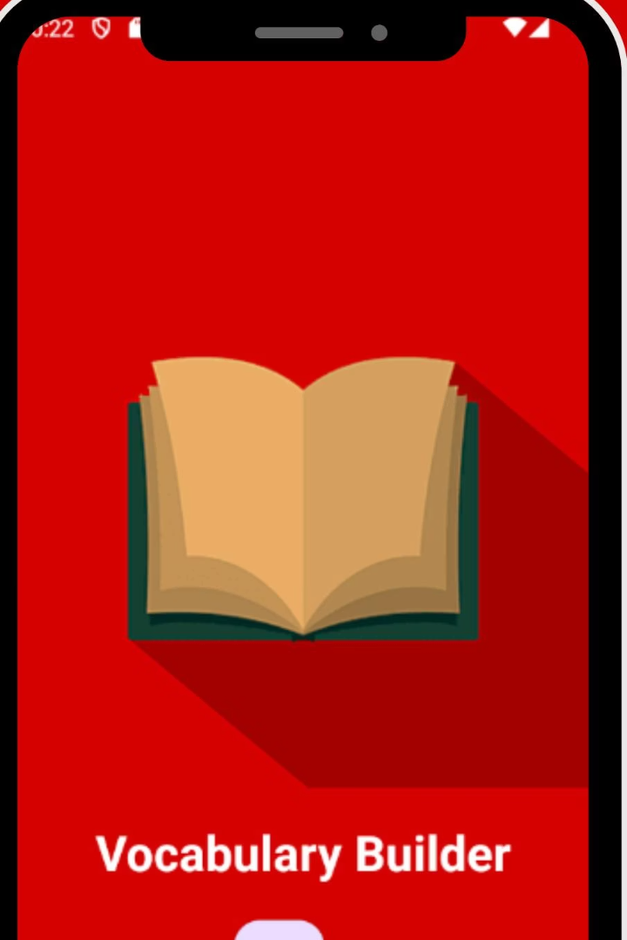



Key Objectives
User-Friendly Interface
Create an intuitive design for seamless user experience.
API Integration
Implement Free Dictionary API for comprehensive word searching.
Firebase Authentication
Establish secure user authentication system.

Slide 4
System Requirements
Software Requirements
Hardware Requirements
Flutter Environment
Dualcore processor or higher
Firebase
4GB RAM minimum
Android Studio
Android Emulator
Dart
Free Dictionary API

Slide 5
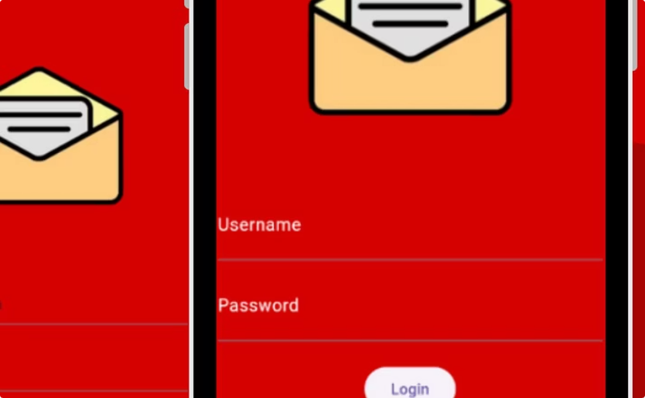
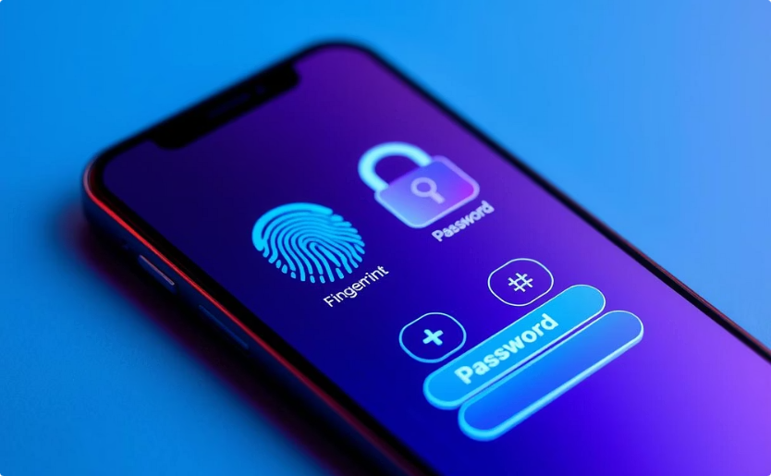
Login Authentication
Login Screen
User Security
Users log in with registered email and password through a clean interface.
Protected access ensures personal progress tracking and customized experience.

Slide 6

Home Page Features
Word Search
Users can search for any word using the search bar at the top of the home page.
Definitions Display
The app fetches comprehensive definitions using Free Dictionary API.
Related Words
Synonyms and antonyms appear to enhance vocabulary connections.

Slide 7








Quiz Platform
Difficulty Selection
Timed Questions
Choose from multiple difficulty levels to match your skills.
Answer questions within a time limit for added challenge.
Score Tracking
Instant Feedback
View your final score upon quiz completion.
See correct answers immediately after selection.

Slide 8







Conclusion & Impact
Enhanced Learning
Revolutionizes vocabulary acquisition through interactive engagement.
Personalized Experience
Adapts to individual learning styles and progress.
Real-World Impact
Equips users with essential language skills for academic and professional success.
The main Focus is to give growing students a better platform to learn and play

